Slide 1



Bed time story application
RNS INSTITUTE OF TECHNOLOGY
BENGALURU - 98
DEPARTMENT OF INFORMATION SCIENCE & ENGINEERING
Presentation on
Internship
BHOOMIKA .S
USN: 1RN18IS033
ENMAZ Engineering Services Pvt. Ltd.
Internal Guide
Mrs. Akshata S Bhayyar
Asst. Prof, Dept of ISE, RNSIT
External Guide
Mr Akshay D R
Co-founder and CEO, Enmaz engineering services

Slide 2
AGENDA
Abstract
About the Company
Introduction
Requirements
System Design
Detailed Design
Implementation
Conclusion and Future Enhancements
References
Department of ISE, RNSIT

Slide 3
ABSTRACT
A bedtime story is a traditional form of storytelling, where a story is told to a child at bedtime to prepare the child for sleep. The bedtime story has long been considered "a definite institution in many families.
Reading bedtime stories yields multiple benefits for parents and children alike. The fixed routine of a bedtime story before sleeping can improve the child's brain development, language mastery, and logical thinking skills.
Bedtime stories are also useful for teaching the child abstract virtues such as sympathy, selflessness, and self-control
This project is implemented using flutter.
Department of ISE, RNSIT

Slide 4
About the Company
Enmaz has a simple yet robust solution that helps any Industry / Factory digitize their workfloor in no time.
The products offered will help in remote monitoring, controlling and also analyzing any machine parameter or process.
Reliable Hardware, Time tested, high quality, designed, developed and manufactured in India. 18 months of replacement warranty.
Department of ISE, RNSIT

Slide 5
INTRODUCTION
Bed time stories is an application developed for people who want to read a story before they sleep. It facilitates to access the story of a particular type in a particular theme. The type of themes available are anxious, kids, love, sleep or the one that contains everything
In the existing system, people do not often get sleep. It may be due to various reasons. Someone may be thinking about something, or they may have work or their kids might not let them sleep. In these cases sleep will be deficit
There are various themes. Stories for kids and adults both are there. The interface is easy to understand user friendly.
Department of ISE, RNSIT

Slide 6
Requirements
Software Requirements
  Operating System : Windows 7 and above
  Coding Language : Dart , flutter
  IDE : Visual Studio Code , Android Studio
Hardware Requirements
  8 GB ROM
  64-bit processor
  2 GB Memory
Department of ISE, RNSIT

Slide 7
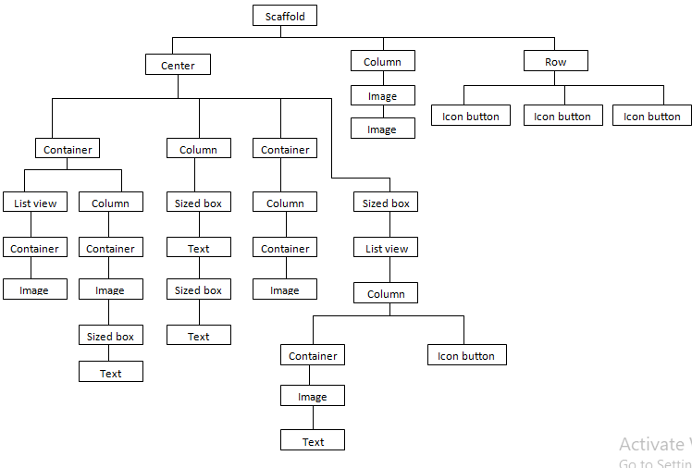
System Design
Widget Tree of Homepage
Department of ISE, RNSIT

Slide 8
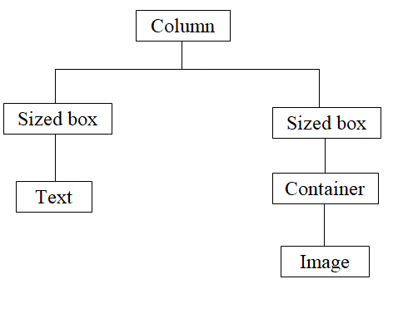
Widget tree of main page
Department of ISE, RNSIT

Slide 9
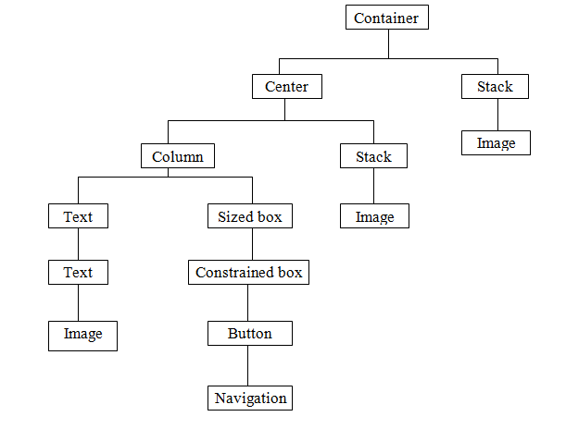
Widget tree of configure page
9/14/19
Department of ISE, RNSIT

Slide 10
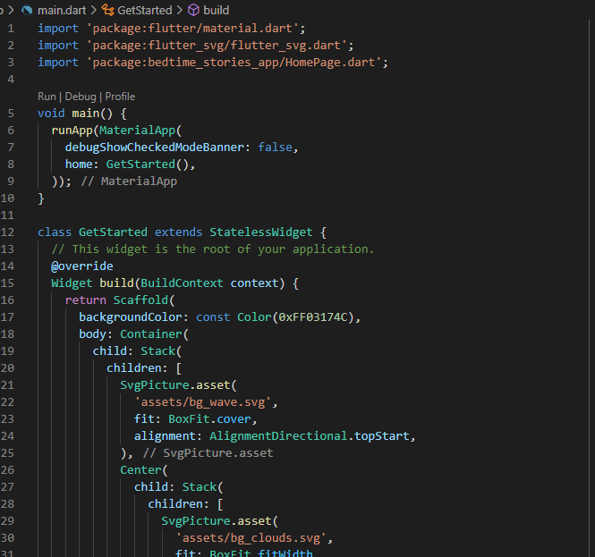
Implementation
Main.dart
Department of ISE, RNSIT

Slide 11
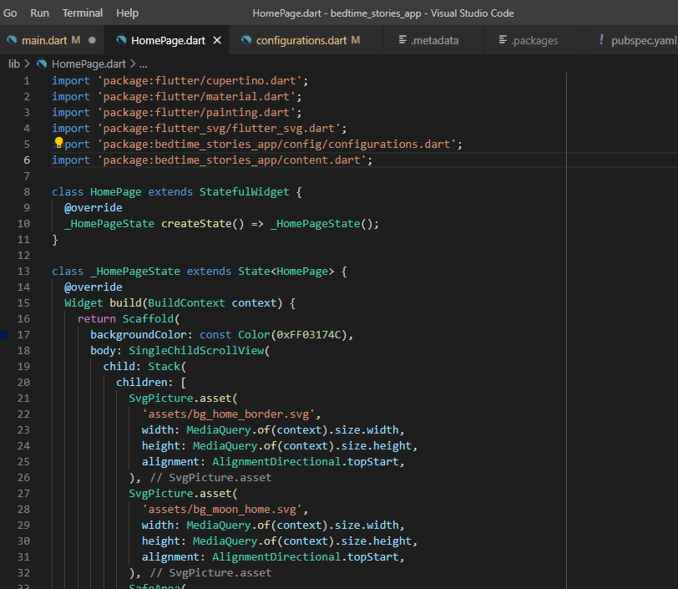
Home.dart
Department of ISE, RNSIT

Slide 12
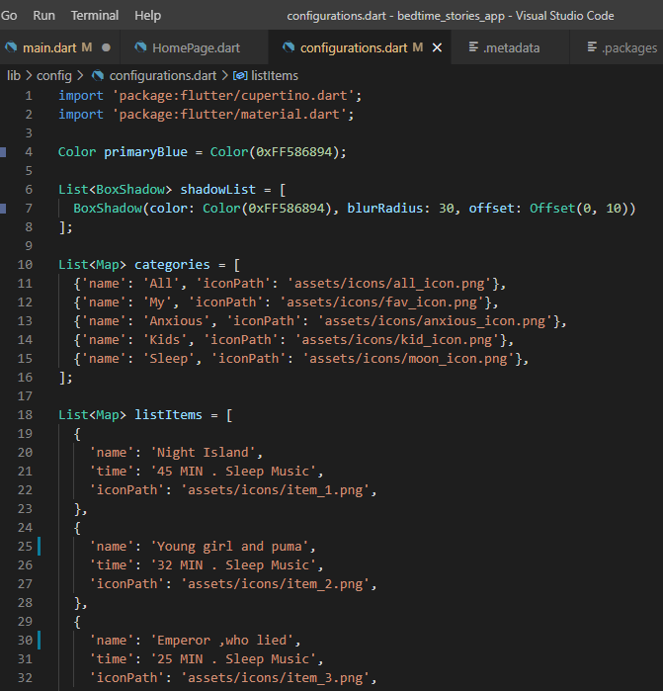
Configuration.dart
Department of ISE, RNSIT

Slide 13
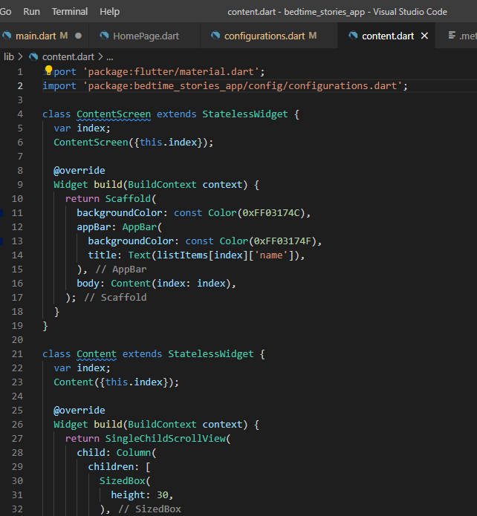
Content.dart
Department of ISE, RNSIT

Slide 14
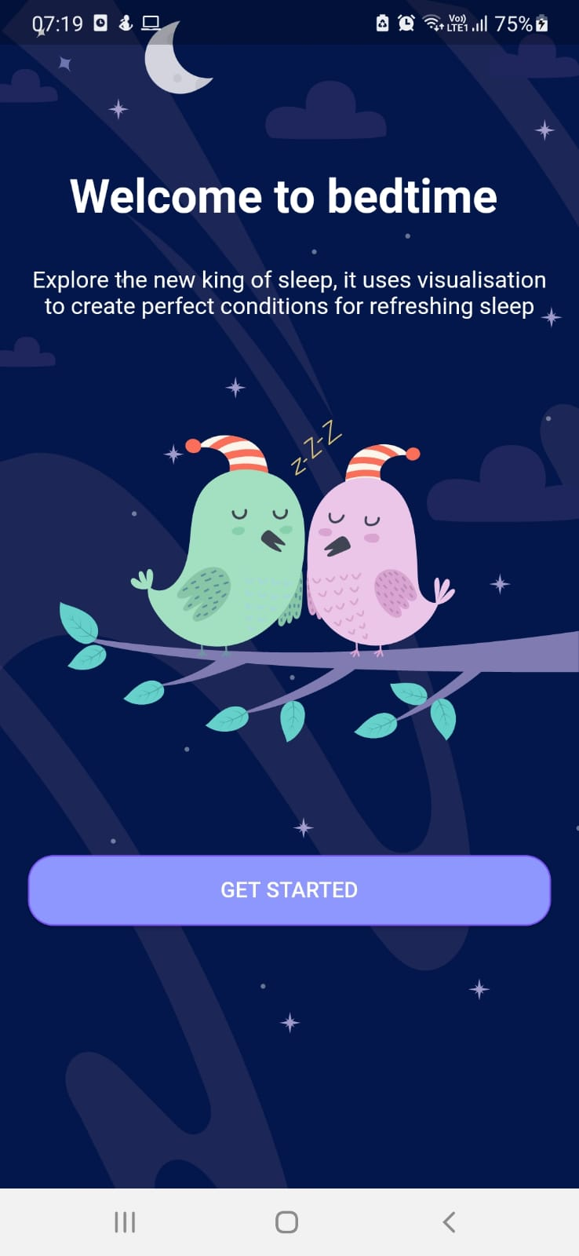
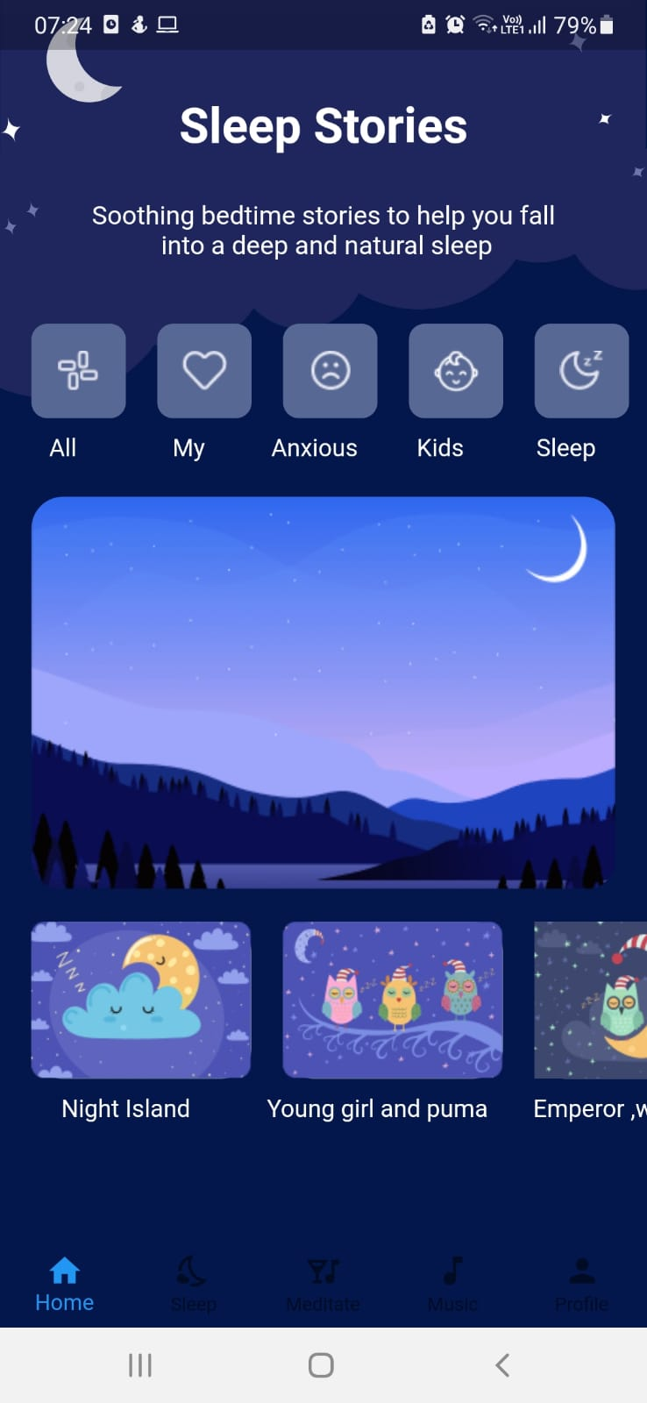
SNAPSHOTS
Department of ISE, RNSIT

Slide 15
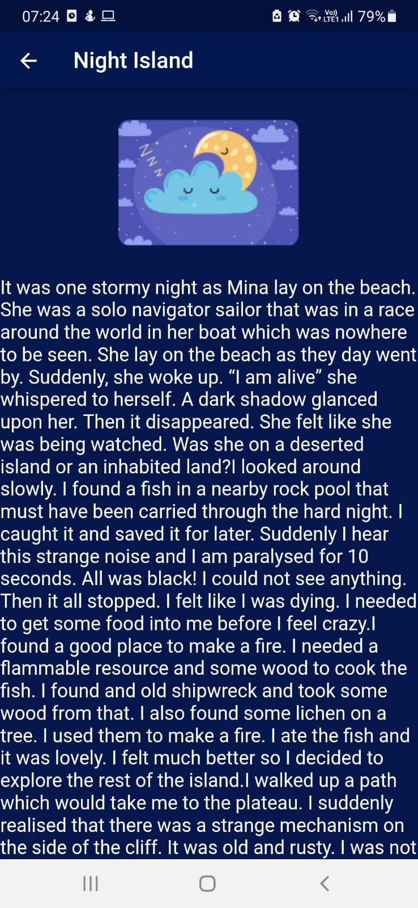
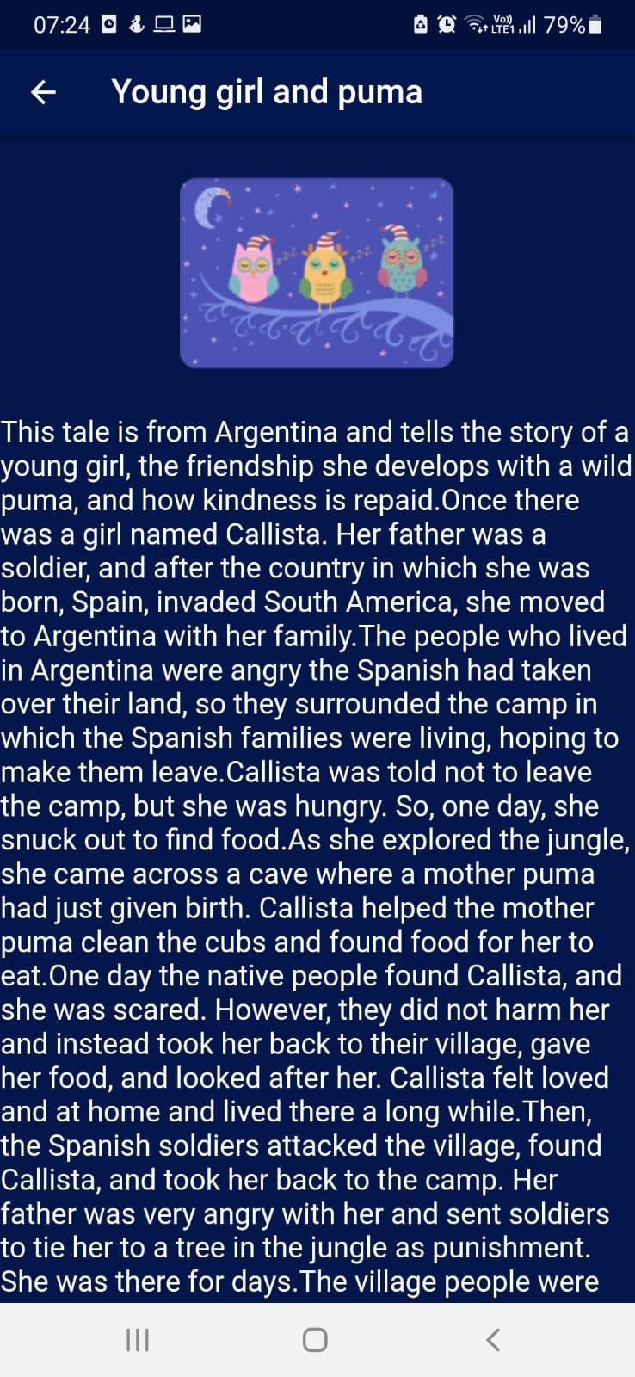
Department of ISE, RNSIT

Slide 16
CONCLUSIONS
A bedtime story is a traditional form of storytelling, where a story is told to a child at bedtime to prepare the child for sleep.
A bedtime story is a traditional form of storytelling, where a story is told to a child at bedtime to prepare the child for sleep The applications will give morals of stories which can good for children in future days.
The app was successfully implemented and designed so that the users can read stories to their children successfully ,improve their hold on the knowledge.
Department of ISE, RNSIT

Slide 17
Future Enhancements
To overcome the drawbacks mentioned above, This project can be developed so that one can search a story of their choice.
We can also some soothing songs in the background which can make you sleep peacefully
We can also do backend part and store as many as stories user want to , this may be also helpful to add user favorites to one folder , Moral stories in one, children's stories in one and many more
Department of ISE, RNSIT

Slide 18
REFERENCES
Flutter : https://docs.flutter.dev/
https://stackoverflow.com/questions/tagged/flutter
The Dart Programming Language book by Gilad Bracha
https://flutter.dev/community
https://en.wikipedia.org/wiki/Bedtime_story
Department of ISE, RNSIT

Slide 19
THANK YOU
Department of ISE, RNSIT

